Slide 1
Classification of
Clonal Haematopoiesis of Indeterminate Potential (CHIP)
Macey Jackson, Nick Phan, Poornisha Senthil Kumar, Sam Cropman, Wei Jie Huang

Slide 2
Background - Data and Information
Two sets of DNA sequencing data collected from two different machines
Varying levels of false negative labelling
Differing accuracy rates arises on models due to label noise
Total of 88 participants; over 1, 000, 000 sequencing reads per dataset
44 CHIP vs 44 Control
Each label remains constant within both datasets

Slide 3
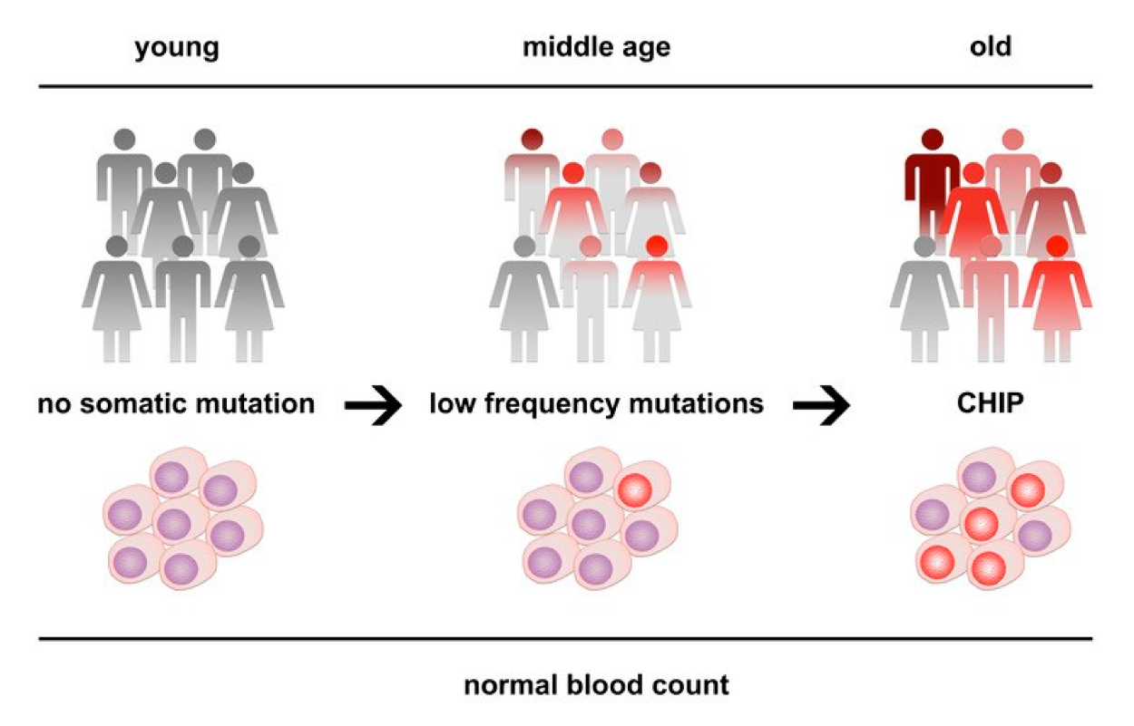
Background - What is CHIP and Key Terms
CHIP is a phenomenon where mutations in specific genes arise over the course of normal ageing.
CHIP leads to adults having a 2-4x higher risk of developing cardiovascular disease or cancer

Slide 4
Key Terms
Variant & Variables
Difference in DNA sequence compared to ‘reference’ sequence
Expressed in allele frequency (AF) as a ratio of read depth (DP)
BIAS provides ratio of reference : variant
If approximately equal, no significant bias is found

Slide 5
Exploratory Data Analysis
& Preprocessing

Slide 6
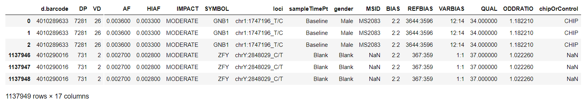
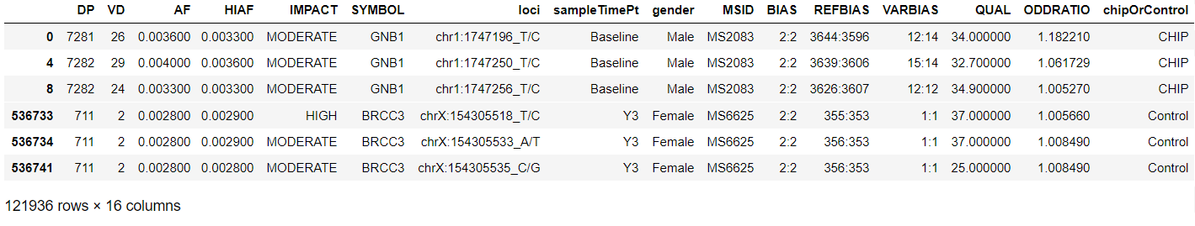
Data Cleaning
chipOrControl drop labels: Unknown / Blank / NaN
Drop duplicate values & d.barcode
Notes:
The first steps of cleaning we carried out was dropping all duplicate rows from our dataset and removing all chipOrControl values which were unknown or blank. This significantly reduced the size of our data frames, reducing the amount of cleaning we had to do for other variables.

Slide 7
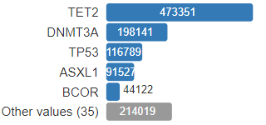
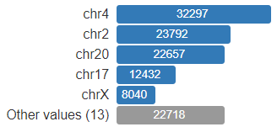

Preprocessing
Gene Frequency
One Hot Encoding on 40 Unique Genes
BIAS, REFBIAS, VARBIAS, str data types
Convert from strings to float values
Split loci
CHR | CHR Location | Nucleotide
18 unique CHR
Attempted One Hot Encoding for CHR
Chromosome Frequency
Notes:
Pre-processing steps undertaken include ‘One Hot Encoding’, we converted CHIP and Control values to 0 and 1 and encoded each of the unique genes symbols as well. Some of the data values were stored as strings so these were converted to float values and we split the ‘loci’ values, each of these containing the chromosome, its location, and the nucleotide. We split these values as we only wanted to use the chromosome classification.

Slide 8
Preprocessing
Gene Frequency
One Hot Encoding on 40 Unique Genes
BIAS, REFBIAS, VARBIAS, str data types
Convert from strings to float values
Split loci
CHR | CHR Location | Nucleotide
18 unique CHR
Attempted One Hot Encoding for CHR
Chromosome Frequency
Notes:
Pre-processing steps undertaken include ‘One Hot Encoding’, we converted CHIP and Control values to 0 and 1 and encoded each of the unique genes symbols as well. Some of the data values were stored as strings so these were converted to float values and we split the ‘loci’ values, each of these containing the chromosome, its location, and the nucleotide. We split these values as we only wanted to use the chromosome classification.

Slide 9
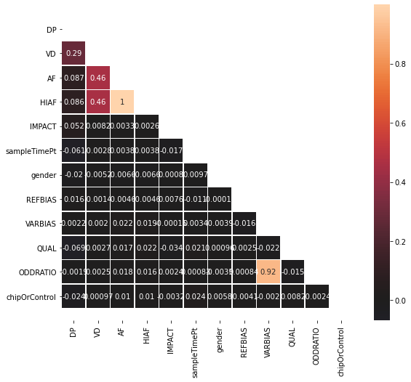
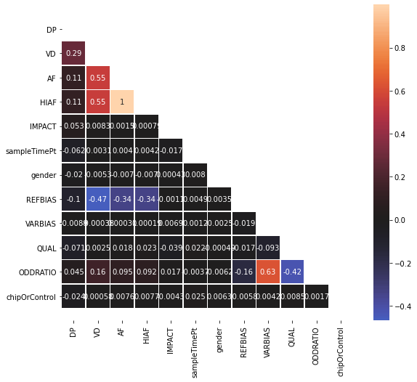
Preprocessing
Before Filtering
After Filtering
Filters: ODDRATIO > 0 ; BIAS = "2:2" or "1:1"
Notes:
We then produced a correlation matrix but found this to be of little use. By filtering the data so ODDRATIO is greater than 0 and bias is 2:2 various correlations increased, this mostly due to the strand bias being removed because of our ODDRATIO boundary. The second correlation matrix shows more and stronger correlation once strand bias is removed.

Slide 10
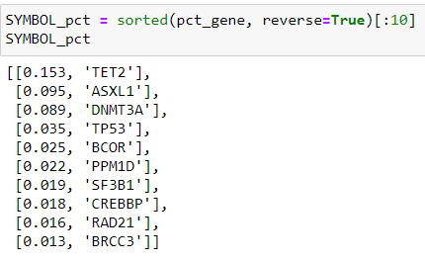
Exploratory Data Analysis
Correlation between SYMBOL and CHIP classification
High correlation between HIAF / AF
ODDRATIO of 0 corresponded to strand bias.
QUAL (quality) metric deterministic of sequencing reliability
Notes:
We found that the SYMBOL and CHIP or control classification were correlated, and that if a specific gene is present, such as TET2, then that read was more likely to be classified as CHIP. The High-Quality Allele frequency read, or HIAF, is correlated to AF and the ODDRATIO of 0 corresponded to strand Bias. We also found that quality determined the reliability of the read, so we would ideally want this value to be closer to 37. We found that the second dataset had a lower quality score on average, leading us to believe this dataset had more noise in comparison to the other dataset.

Slide 11
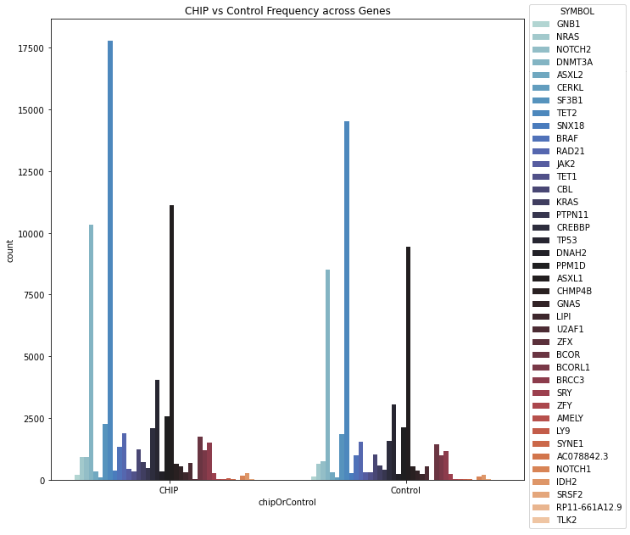
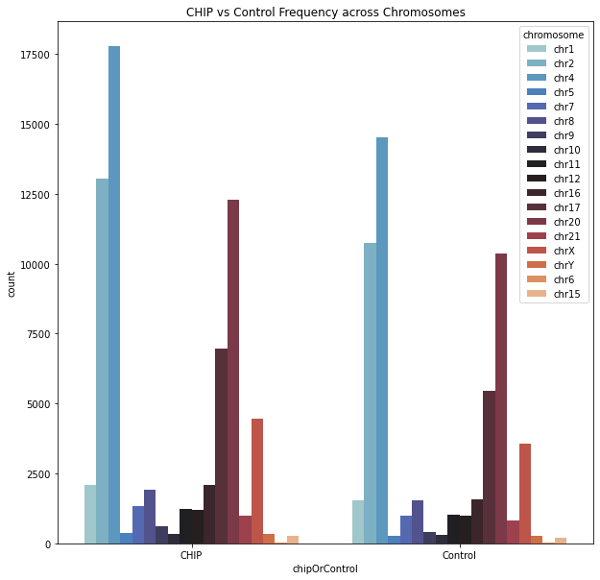
Exploratory Data Analysis
Notes:
Looking into the data on the different genes and chromosomes recorded we found that there was a high correlation between the two, for example chromosome 4 and TET2 gene. From this we kept the top 5 correlated gene and chromosome pairs in our dataset and proceeded to begin modelling.

Slide 12
Exploratory Data Analysis
Notes:
Looking into the data on the different genes and chromosomes recorded we found that there was a high correlation between the two, for example chromosome 4 and TET2 gene. From this we kept the top 5 correlated gene and chromosome pairs in our dataset and proceeded to begin modelling.

Slide 13
Modelling
Notes:
So, I will be talking about modelling our data.

Slide 14
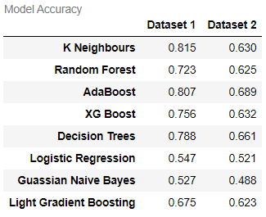
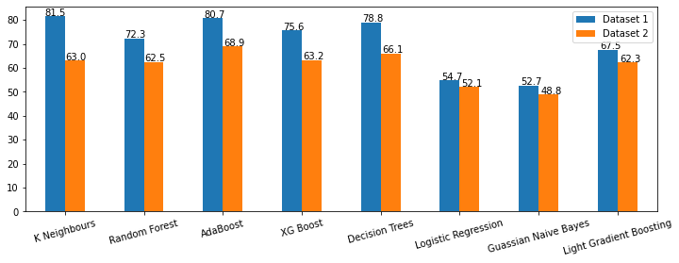
Modeling Comparison
Notes:
Firstly, from this graph comparing different models on our dataset, you can see that our best three models are K nearest neighbours, adaboosting and decision trees/random forests. In addition, dataset 1 consistently had higher accuracies, leading us to believe that dataset 1 contains less false positive than dataset 2

Slide 15
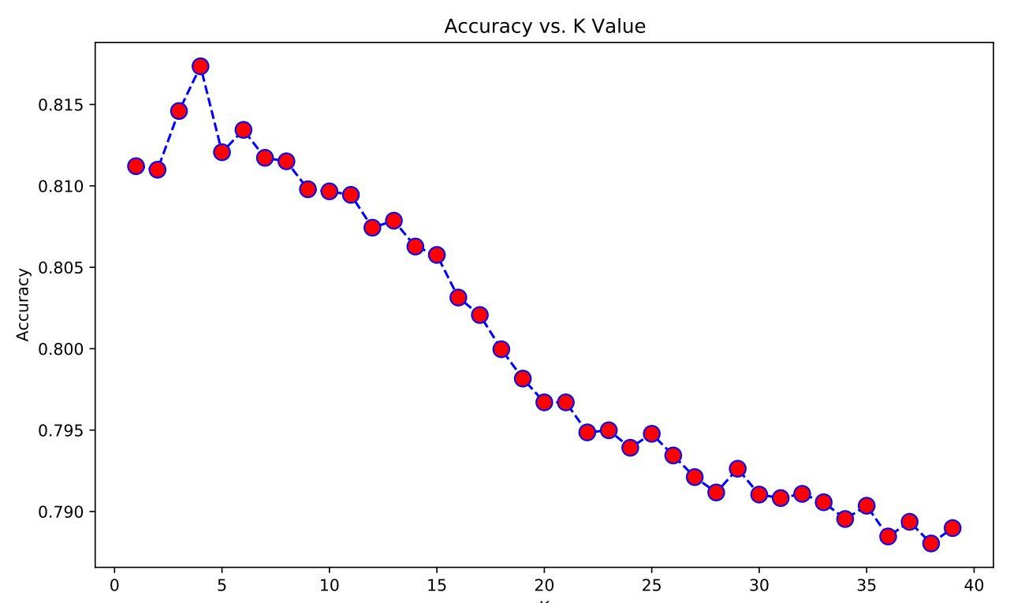
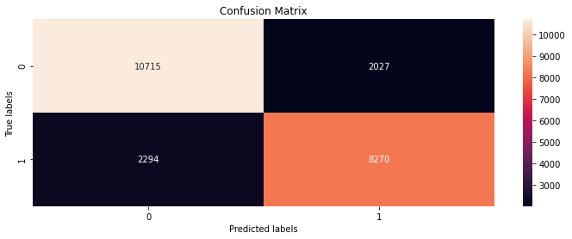
KNN Model
81.5% - Best Accuracy with K = 3, dataset1
63% accuracy within dataset2
Notes:
Our most accurate model was K Nearest Neighbours, with an accuracy score of around 82%.
K Nearest Neighbours is a simple supervised machine learning algorithm that operates by calculating the distance of a data point to all old existing training points. It then selects K nearest data points, where K is an integer, and then assigns this new data point the same class as the class of majority of K nearest data points, that being either CHIP or Control.
K Nearest Neighbours is much faster than most algorithms because it does not require training before making predictions. From this graph, we can see that the highest accuracy came from when K was set to equal 3, which meant that for the best results, each new point was determined by its three nearest neighbours.

Slide 16
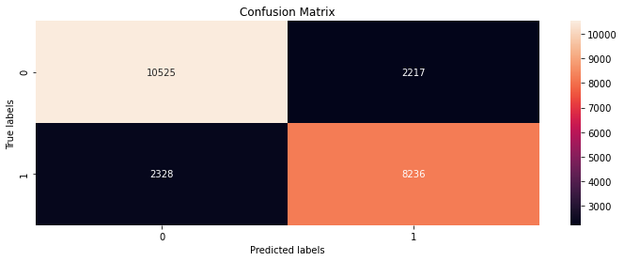
AdaBoost
Accuracy of 80.9%
Optimal Learning Rate: 0.2, Optimal Iterations: 45
SAMME resulted in better scores than SAMME.R
Notes:
Our second most accurate score came from Adaboosting, with an accuracy score of around 81%.

Slide 17
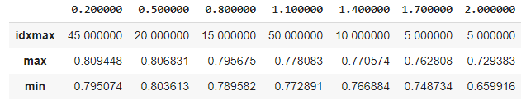
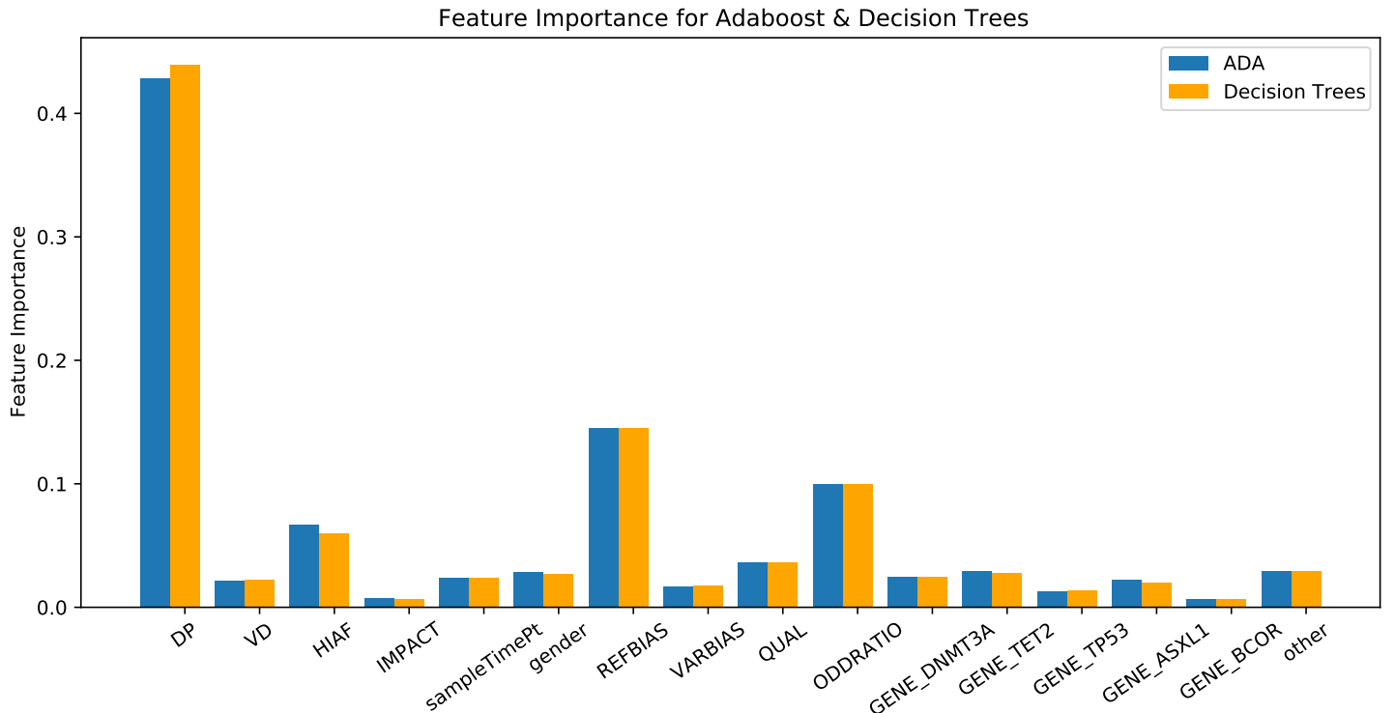
Adaboosting Results
Notes:
Adaboosting works by combining multiple weaker classifiers into a single strong one. It puts weights with each observation and then increasing the weights on difficult to classify instances and decreases the weights on those already handled well. We decided to use Decision Trees as our estimator as it led to the highest results.

Slide 18
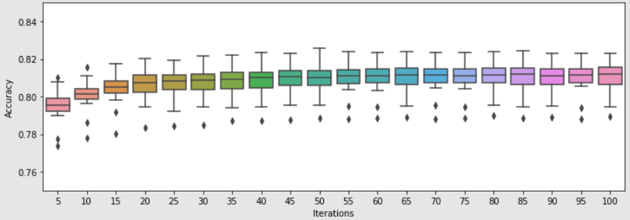
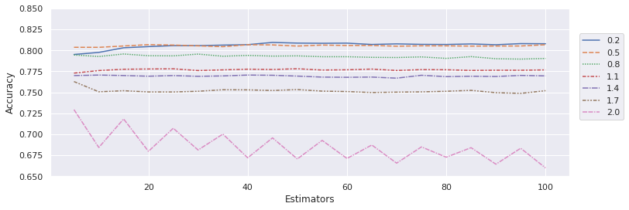
Accuracies for Learning Rate = 0.2
Accuracies for Learning Rate vs Estimators
Notes:
From the graphs above you can see that the optimal learning rate was 0.2 with 45 iterations. Similarly, using a learning rate of 0.5 also led to accuracies of over 80%. In addition, Using SAMME instead of SAMME.R, which is the default Adaboosting algorithm, led to higher accuracies.

Slide 19

Random Forests / Decision Trees
Random Forests: 72.4%
Decision Trees: 78.6%
Notes:
Finally, for Random Forests, we had an accuracy score of around 72% and an accuracy of 78% for decision trees.
Random forests are an ensemble of uncorrelated decision trees which have been aggregated to create a more accurate classifier.
We suspect that the higher accuracy from the decision tree is due to overfitting. Our random forest would have a similar bias to the underlying decision trees, but a much lower variance, hence, the lower accuracy.

Slide 20
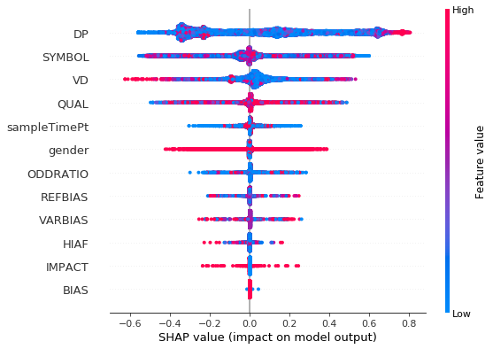
SHAP Values
Variable importance plot for dataset 1
The SHAP value indicates the impact a feature has on the models prediction.
Comparing same model run on different datasets.
The variable plot demonstrates the feature importance, impact on model and the correlation
More defined shape gives clearer indication of impact.
Notes:
After data modelling, we wanted to explore the reasons for the lower accuracies in the second dataset. So, to investigate the differences in the two datasets, we used the shap values to plot figures that can provide a more transparant view of the two datasets. Shap values shows how much each feature contributes either positively or negatively, to the target variable. Firstly, a variable important plot is created for the two datasets to see the variables that contributed the most to the model's outcome.

Slide 21
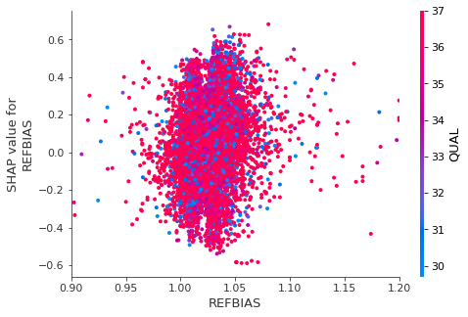
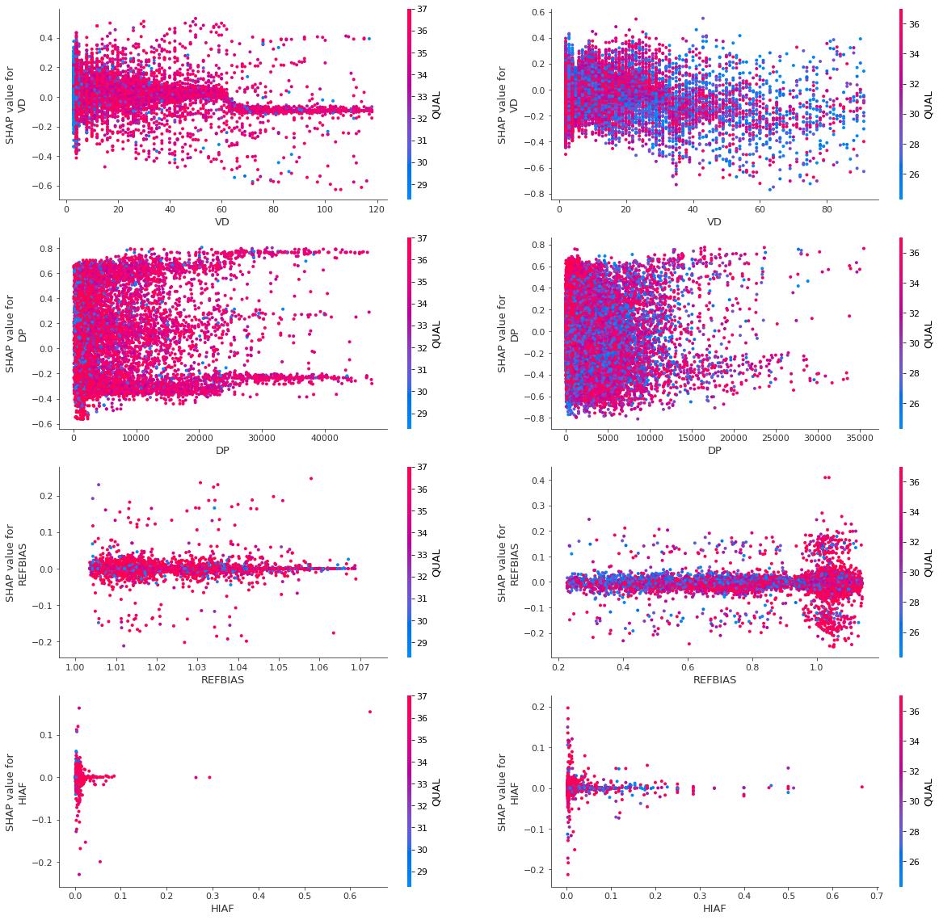
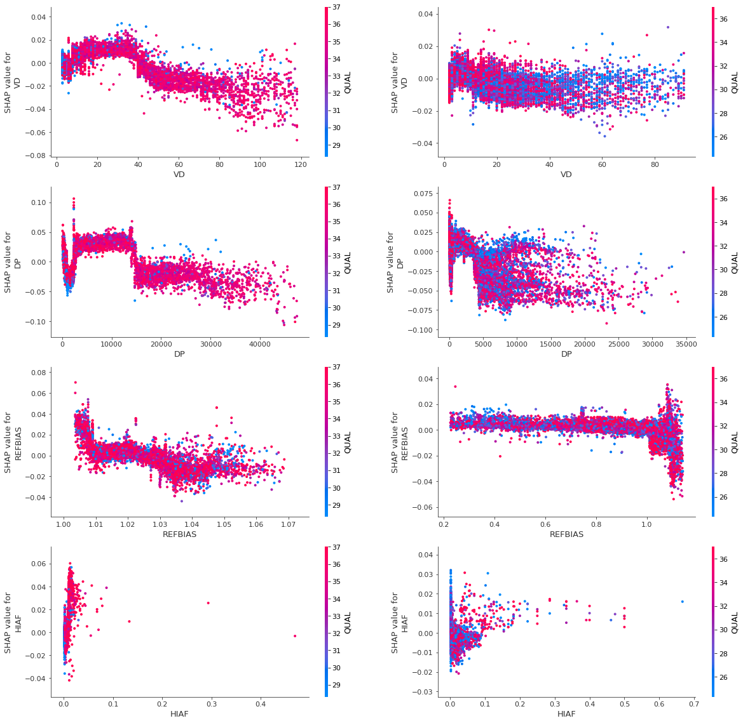
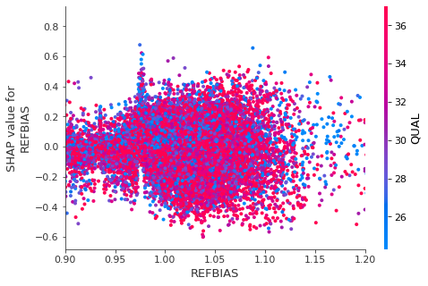
SHAP Values
KNN model
Random Forest classifier
ADABoost
Dataset 1
Dataset 1
Dataset 1
Dataset 2
Dataset 2
Dataset 2
Notes:
Then, dependence plots for three models were created which shows the effect a feature has on the predicted outcome.
The colour in the data points correlates to the variable quality reading and the left y-axis show the shap values where higher shap values represent an increased possibility of a chip variant. From KNN model's plot and specifically for dataset 1, we can see that when VD ranges from 60-120, the data points are clustered towards a negative shap value implying the varient being chip negative that is control. Wheareas for dataset 2, its hard to predict theoutcome beacause the points are more spread out than the first one's.
A similar result can be seen from the plots for the other two models. Two common things from the plots of the different datasets is : One - The variation of shap values in dataset 2 is larger than d1 suggesting a variation in the model's ability to be able to predict the chip or control is also high. The second point is the colour of these plots. Dataset 1 have its data points mostly coloured in pink compared to d2 whcih correltes to a quality reading of 35 and above. Thereby the pink dots representing more accurate reads of the data. Overall, the lower qual readings and the larger variance in dataset 2 could be contributing factor for d2's lower accuracy.

Slide 22
SHAP Values
KNN model
Random Forest classifier
ADABoost
Dataset 1
Dataset 1
Dataset 1
Dataset 2
Dataset 2
Dataset 2
Notes:
Then, dependence plots for three models were created which shows the effect a feature has on the predicted outcome.
The colour in the data points correlates to the variable quality reading and the left y-axis show the shap values where higher shap values represent an increased possibility of a chip variant. From KNN model's plot and specifically for dataset 1, we can see that when VD ranges from 60-120, the data points are clustered towards a negative shap value implying the varient being chip negative that is control. Wheareas for dataset 2, its hard to predict theoutcome beacause the points are more spread out than the first one's.
A similar result can be seen from the plots for the other two models. Two common things from the plots of the different datasets is : One - The variation of shap values in dataset 2 is larger than d1 suggesting a variation in the model's ability to be able to predict the chip or control is also high. The second point is the colour of these plots. Dataset 1 have its data points mostly coloured in pink compared to d2 whcih correltes to a quality reading of 35 and above. Thereby the pink dots representing more accurate reads of the data. Overall, the lower qual readings and the larger variance in dataset 2 could be contributing factor for d2's lower accuracy.

Slide 23
Plot Results
Random Forest classifier
ADABoost
Dataset 1
Dataset 1
Possible factors for the lower accuracy in dataset2:
Larger variance in the second dataset
Large quantity of pink dots in dataset 1
Suggests higher quality reads
Dataset 2
Dataset 2

Slide 24
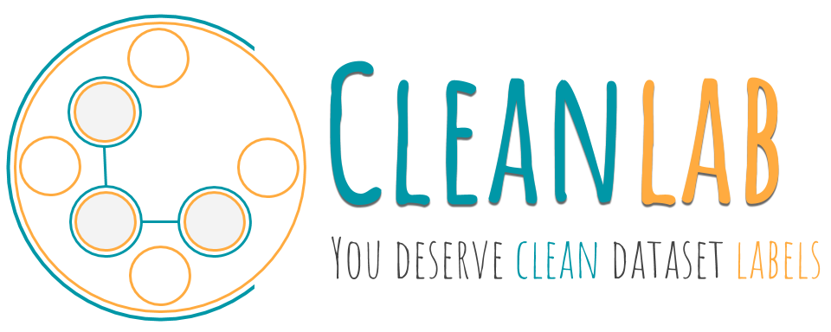
Label Noise
Improve models by changing binary classifications of labels
Patient MSID groupings allows for flipping labels easily
Utilise cleanlab, a Python library for machine learning with noisy labels.
Labels and supports finding, quantifying, and learning with label errors in datasets.
Less than favourable results
Decreased model accuracies across the board by about 2-5%

Slide 25
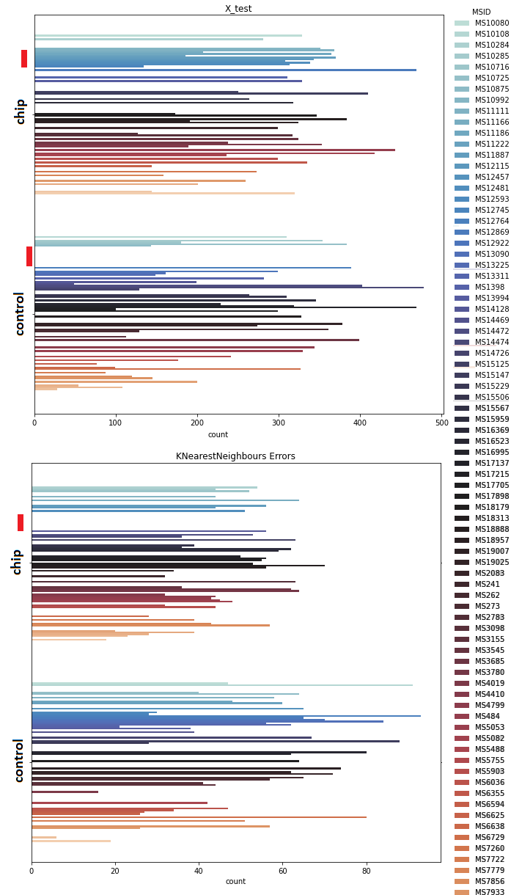
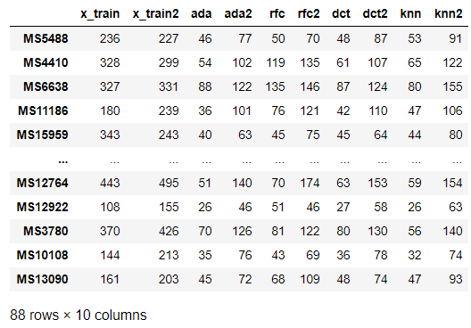
Label Noise
Find sequencing noise through model comparisons
Group model accuracies by MSID identifier
Sum of model inaccuracies per MSID

Slide 26
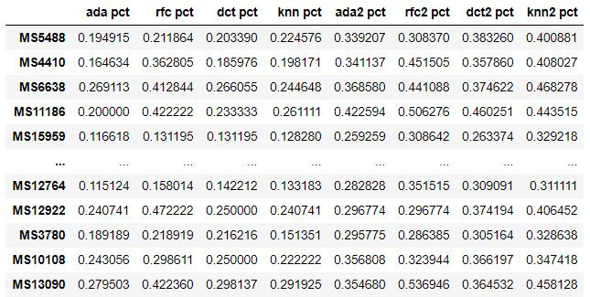
Label Noise
Find sequencing noise through model comparisons
Group model accuracies by MSID identifier
Find error rate for each model

Slide 27
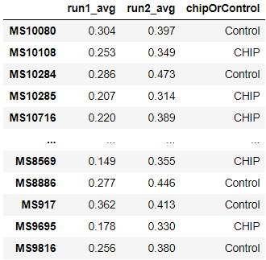
Label Noise
Find sequencing noise through model comparisons
Group model accuracies by MSID identifier
Find error rate for each model
Average model error, apply filter with error minimum

Slide 28
Label Noise
Find sequencing noise through model comparisons
Group model accuracies by MSID identifier
Find error rate for each model
Average model error, apply filter with error minimum
30% and 35% average model error respectively

Slide 29
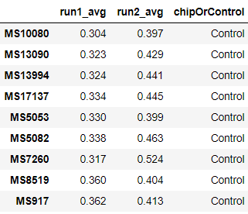
Label Noise
Find sequencing noise through model comparisons
Group model accuracies by MSID identifier
Find error rate for each model
Average model error, apply filter with error minimum
30% and 35% average model error respectively

Slide 30
Label Noise
Recall control labels had inaccuracies

Slide 31
Label Noise
Recall control labels had inaccuracies
Flip binary classifications on particular MSID labels
Run models again

Slide 32
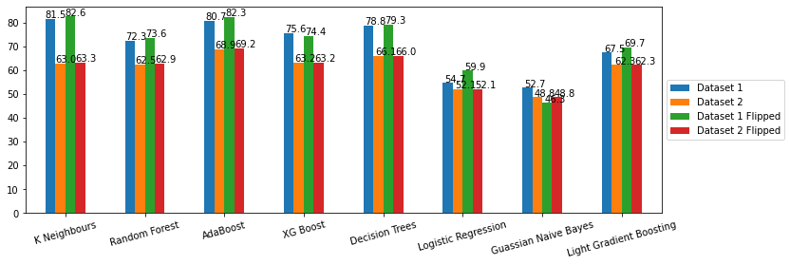
Label Noise
Recall control labels had inaccuracies
Flip binary classifications on particular MSID labels
Run models again
Accuracies improve by miniscule amount in most cases.

Slide 33
Conclusions

Slide 34
Summary & Improvements
Project Takeaways:
KNN + AdaBoosting achieved over 80% accuracy
Variables: DP, REFBAIS, ODDRATIO, HIAF, are indicative features for CHIP classification
Improvements:
Label noise not identified properly identified
Apply neural networks to classification problem
Apply predictive learning with structured data (MSID)

Slide 35
Thank You

